Slide 1

MINUTES OF MEETING
AI-Powered Enterprise Meeting Assistant

Slide 2
FYP-I Deliverables?
Literature Review
Data Collection
OCR
Clustering the discussion according to Agenda
Classifying the sentence − Suggestions, Task Assigned or Normal

Slide 3
Literature and Application Review

Slide 4
Literature Review
Improved Keyword and Keyphrase Extraction from Meeting Transcripts by Immanuvel Rajkumar, Sheeba & Vivekanandan, Kumuda
A Supervised Framework for Keyword Extraction From Meeting Transcripts. Audio, Speech, and Language Processing by Liu, Fei & Liu, Feifan & Liu, Yang
Rapid Keyphrase extraction from audio transcripts of video lectures by Aruna, V. & Harini, S. & Ranjitha, R. & Palanivel
Text categorization with support vector machines: Learning with many relevant features by Joachims, Thorsten
The probability ranking principle in IR by Robertson, Stephen E.
Speaker diarization with LSTM by Wang, Quan, et al.

Slide 5
Application Review
REASON8.AI
Mobile Application - Each participant needs the app on their mobile
OTTER.AI
Mobile Application - On single mobile
Import audio and video, take snap of meeting and embed it to meeting notes.
VOCIEA.COM
Mobile and Web Application
Harder to Setup
Uses an AI assistant as the way to capture your meeting notes.

Slide 6
Audio Transcription
Speech to Text
Speech Diarization

Slide 7
Possible Options
Python Open Source Speech Recognition
Only Speech to Text no Speech Diarization
Not good with noisy data (noise improvement tests were performed)
Amazon Transcribe
Costly as compared to GCP
Not good with names and Pakistani Accent
Can add some text regarding the meeting
GCP
Less costly as compared to Amazon and have some free credits
Better Speech Diarization
Not good with names
TEMI
Costly and no free trial APIs available
Only free online tool to perform Audio Transcription

Slide 8
Issues Faced
Can be easily changed latter at any time
Independent of all the other methodology
Not enough credits were there to run a complete test
Not able to get Meeting Audio Dataset
But got a dataset of 68 Meeting Transcription in Text Form that contains
Meeting Agenda List
Meeting Attendees List
Meeting Transcription with Speech Diarization
Some Metadata regarding meeting
Notes:
`

Slide 9
Speaker Diarization with LSTM
Working of GCP Transcription
Literature Review

Slide 10
Speaker Diarization with LSTM
Speaker diarization is a combination of speaker segmentation and speaker clustering
The first aims at finding speaker change points in an audio stream
The second aims at grouping together speech segments on the basis of speaker characteristics
Diarization != Source separation
Not assuming overlapped speech, either remove it or ignore it
No enrollment, voice prints of previous speakers are not registered

Slide 11
Anatomy of Speaker Diarization Systems
Speech Detection
Use Voice Activity Detector (VAD) to remove noise and non-speech
Speech Segmentation
Extract short segments each containing a single speaker
Embedding Extraction
Generate a compact representation for each segmentation (i-vector, d-vector)
Clustering
Determine the number of speakers
Assign each speech segment to a single speaker
Resegmentation (Optional)
Further smooth the diarization results

Slide 12
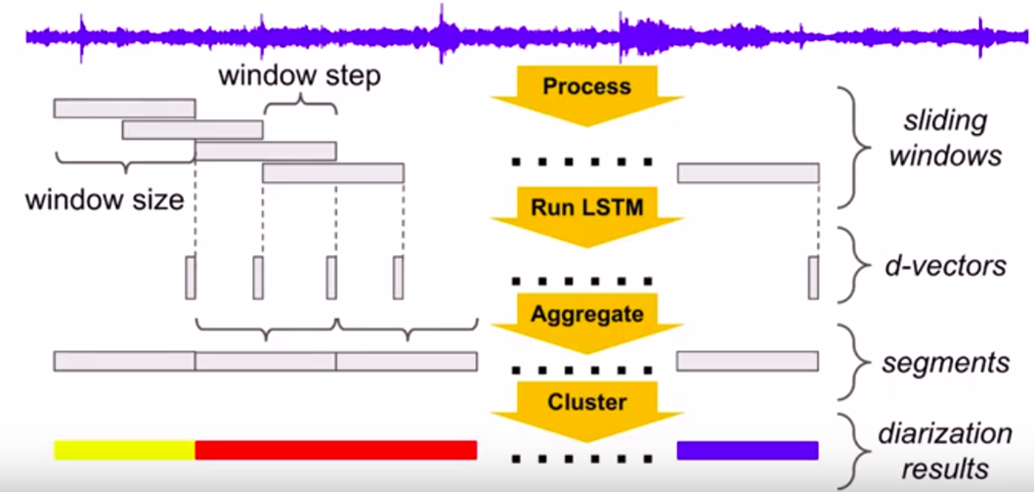
Anatomy of Speaker Diarization Systems

Slide 13
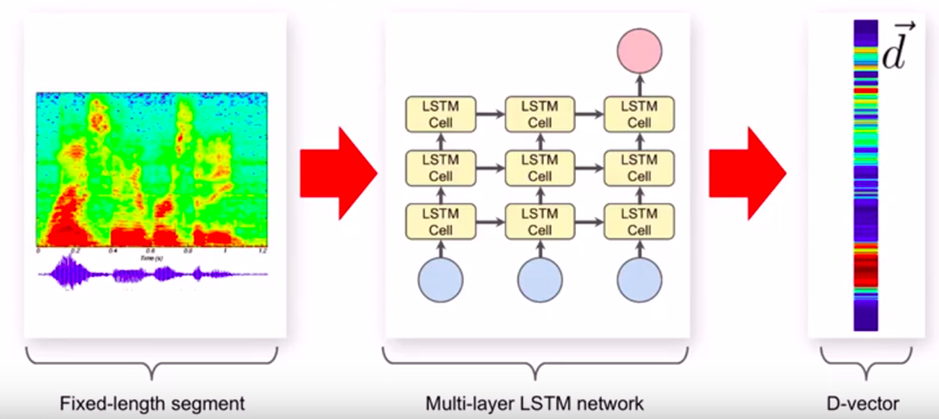
D-Vector - Audio to ensembling

Slide 14
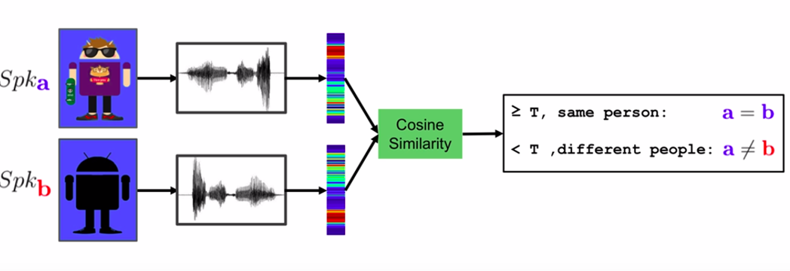
Verification Decision - Thresholding Cosine Similarity

Slide 15
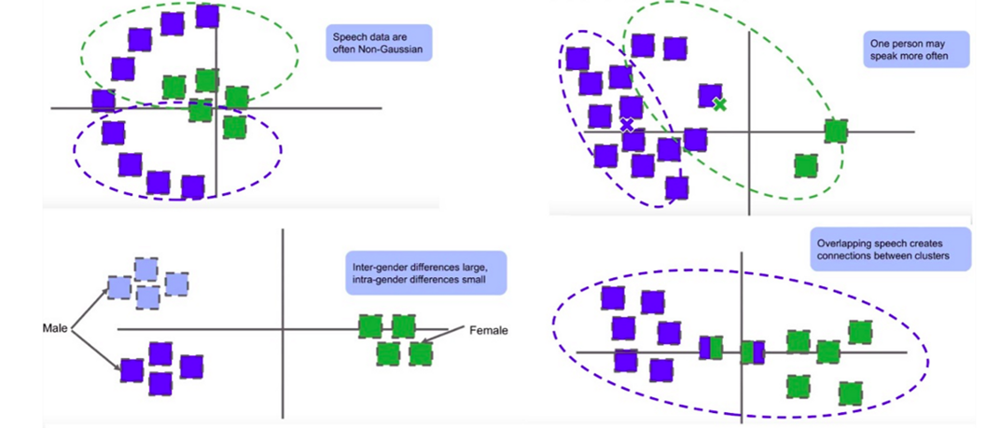
K-Means does not work well on Non Gaussian data

Slide 16
Spectral Clustering: Affinity Matrix
Construct the affinity matrix using cosine similarities
Apply a sequence of refinement operations — key to the success
Gaussian blur Smooth the data, and reduce the effect of outliers
Row-wise thresholding Zero-out affinities between different speakers
Symmetrization Restore matrix symmetry
Diffusion Sharpen affinity section boundaries of distinct speakers
Row-wise max normalization Avoid undesirable scale effects

Slide 17
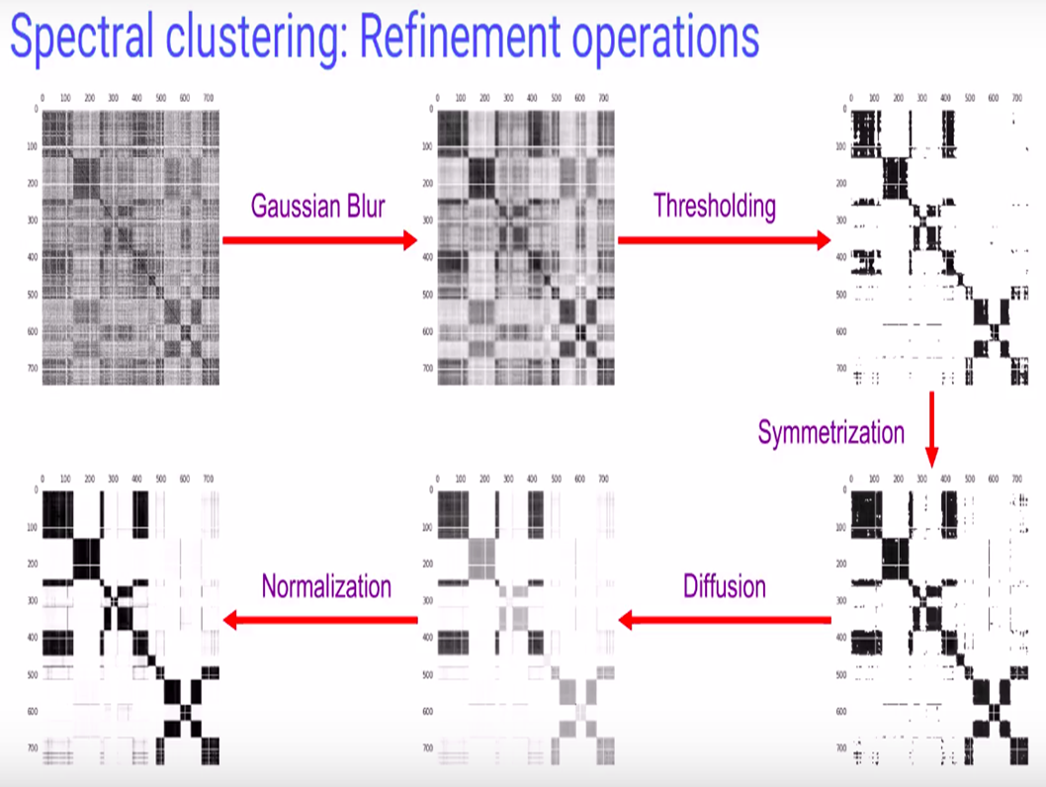
Spectral Clustering - Refinement Operations

Slide 18
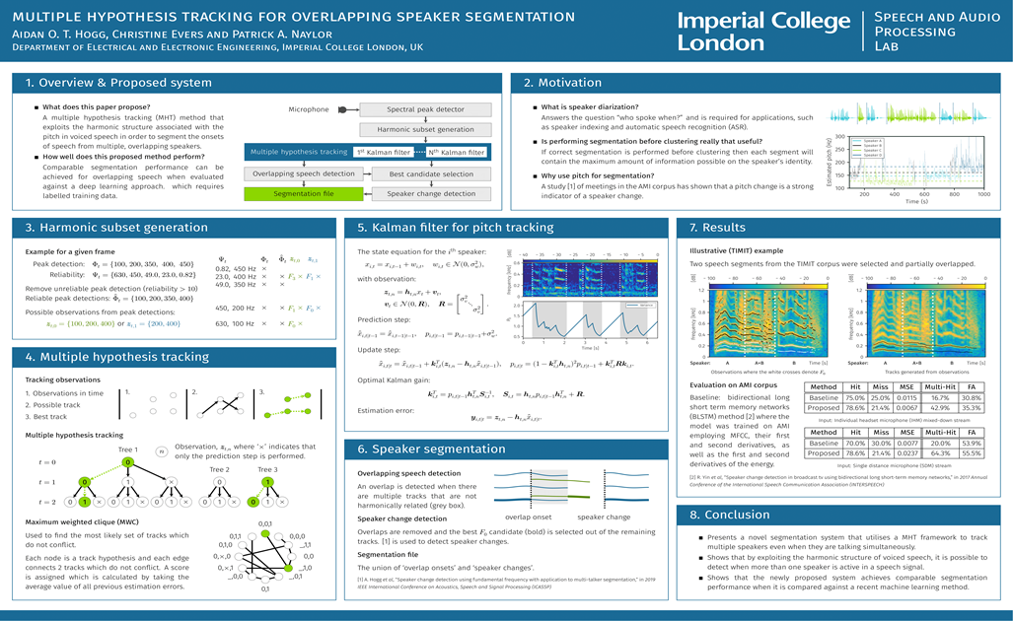
Speaker Change Detection Using Fundamental Frequency

Slide 19
Optical Character Recognition
Text to Image

Slide 20
Possible Options
Pytesseract
Python Library for OCR
Free Solution
Almost Perfect results for Computerized Images
Not upto the mark for Handwritten Images
Google Cloud Vision
Google AI Service
Costly Solution
Almost Perfect results for Computerized Images
Almost Perfect results for Handwritten Images

Slide 21

Optical Character Recognition

Slide 22
PreImage Processing
Tesseract works best when there is a very clean segmentation of the foreground text from the background
In practice, it can be extremely challenging to guarantee these types of segmentations
Hence, we tend to train domain-specific image classifiers and detectors

Slide 23
Rescaling
Tesseract works best on images which have a DPI of at least 300 dpi, so it may be beneficial to resize images.
cv2.resize(img, None, fx=1.2, fy=1.2, interpolation=cv2.INTER_CUBIC)``

Slide 24
Binarisation
This is converting an image to black and white. Tesseract does this internally (Otsu algorithm)
#simple
cv.threshold(img,127,255,cv.THRESH_BINARY)
#adaptive
cv2.adaptiveThreshold(img, 255, cv2.ADAPTIVE_THRESH_GAUSSIAN_C, cv2.THRESH_BINARY, 31, 2)
#otsu
cv2.threshold(img, 0, 255, cv2.THRESH_BINARY + cv2.THRESH_OTSU)[1]

Slide 25
Noise Filtering
Gaussian blurring for gaussian noise
Median Filtering for salt and pepper noise
Bilateral filtering, useful for removing the noise without smoothing the edges unlike gaussian
Wiener for speckle noise

Slide 26
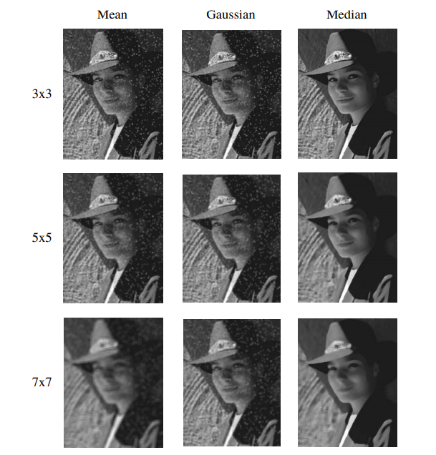
Comparison - Salt and Pepper Noise

Slide 27
Morphological Operations
Erosion shrink image regions
Dilation grow image regions
Opening Erosion followed by dilation. It is useful in removing noise
Closing Dilation followed by Erosion. It is useful in closing small holes inside the foreground objects (connecting bridges)

Slide 28
Tesseract’s Limitations
Tesseract isn’t trained to recognize handwriting, and it’s limited to about 100 fonts in total
Tesseract requires preprocessing to improve the OCR results: Images need to be scaled appropriately, have as much image contrast as possible, and the text must be horizontally aligned
Works best for structured data

Slide 29
Comparison 1
Pytesseract
Lk MOVE to stoe Mr. Gots keQQ from
Google Cloud Vision
A MOVE to otor Mr . Gaits kell from

Slide 30
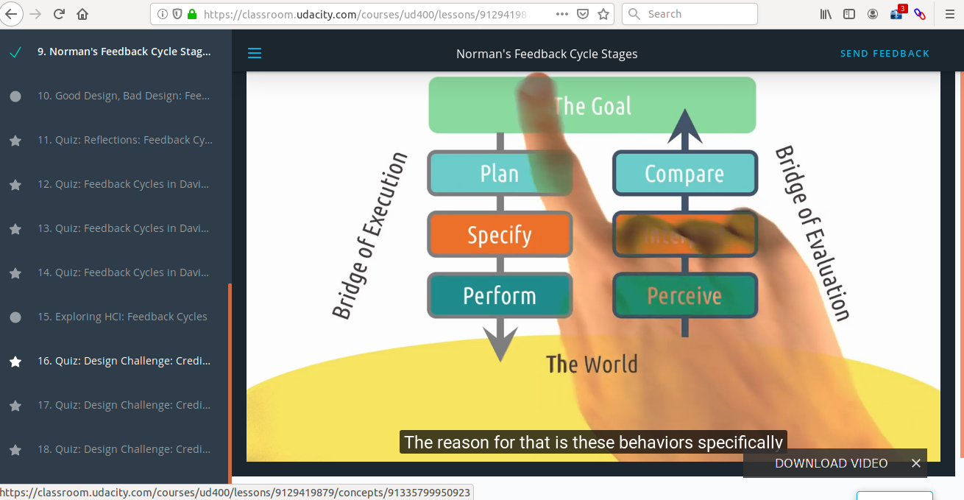
Comparison 2
Pytesseract
Lk MOVE Norman's Feedback Cycle Stages PNPM atts Ces
The reason for that is these behaviors specifically
DOWNLOAD VIDEO
https://classroom.udacity.com/courses/ud400/lessons/9129419879/concepts/91335799950923
Google Cloud Vision
Norman ' s Feedback Cycle Stag . . .
The reason for that is these behaviors specifically DOWNLOAD VIDEO X https : / / classroom . udacity . com / courses / ud 400 / lessons / 9129419879 / concepts / 91335799950923

Slide 31
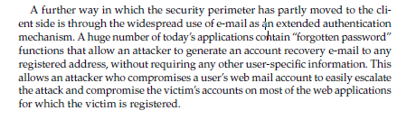
Comparison 3
Pytesseract
‘A further way in which the security perimeter has partly moved to the cli-
‘ent side is through the widespread use of e-mail as jn extended authentication
mechanism. A huge number of today’s applications cohtain “forgotten password” ...
Google Cloud Vision
A further way in which the security perimeter has partly moved to the cli ent side is through the widespread use of e - mail as 4n extended authentication mechanism ....

Slide 32
Clustering of Meeting Discussion According to Agenda List

Slide 33
Tried Combinations
Clustering Algorithms
K-Means
Agglomerative
Gaussian Mixture
Tokenizers
Tf-idf Vectorizer
Count Vectorizer
Document Embeddings
Some Other Things
Removal of Stopwords or not
Lemmatization
Stemming
Bag of Words
Note - PRP Model

Slide 34
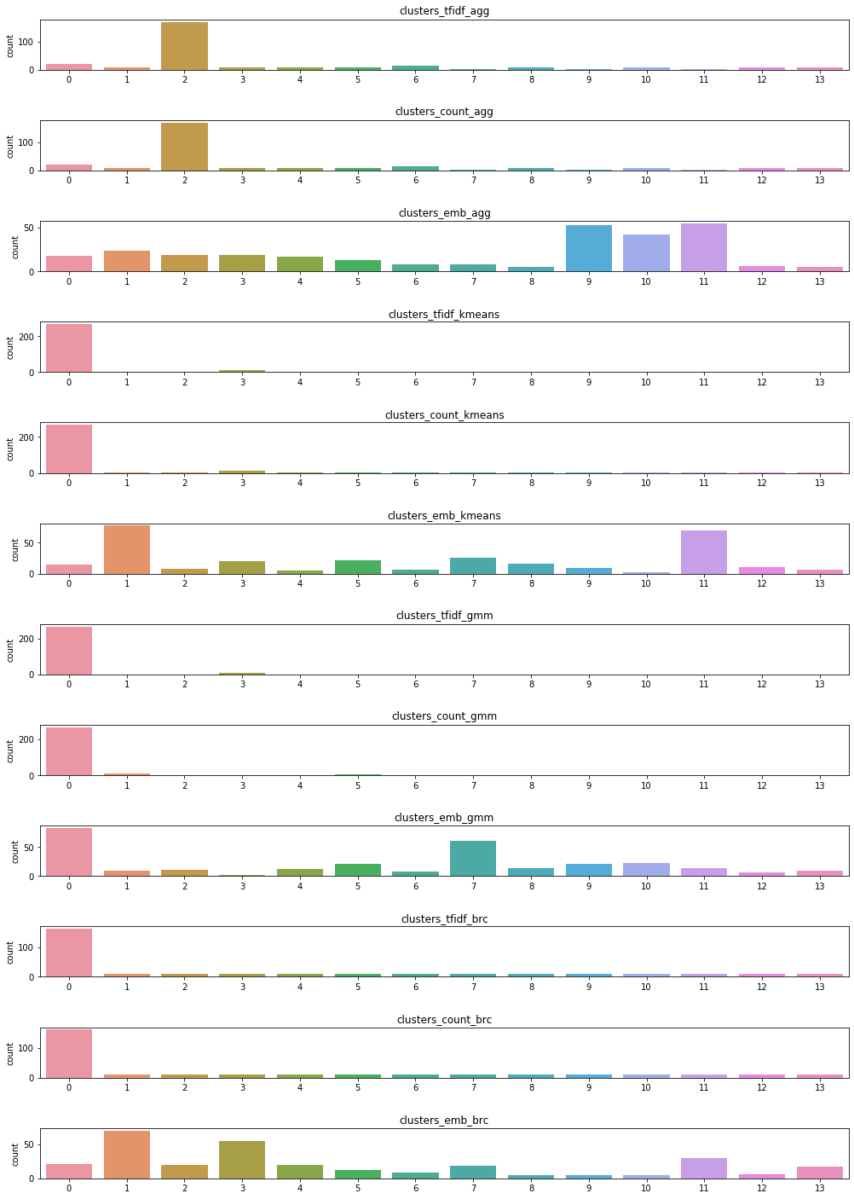
Sentence Distribution
Notes:
`

Slide 35
Issues Faced
We thought that K-Means will work better
As agglomerative is been selected so we have to do Topic Modelling too
PRP was expected solution but was not upto the mark
What criteria be for marking a word relevant
May be the data is not of that quality
Agenda list provided is not the real agenda
Use of too many abbreviations
Notes:
`

Slide 36
Probability Ranking Principle PRP
Literature Review

Slide 37
What is PRP?
“If a reference retrieval system’s response to each request is a ranking of the documents in the collection in order of decreasing probability of relevance to the user who submitted the request, where the probabilities are estimated as accurately as possible on the basis of whatever data have been made available to the system for this purpose, the overall effectiveness of the system to its user will be the best that is obtainable on the basis of those data.”
Notes:
`

Slide 38
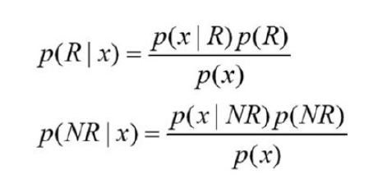
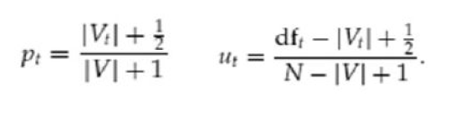
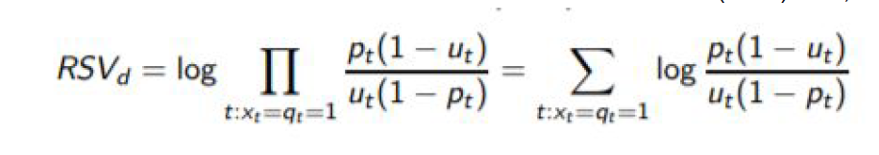
Mathematical Representation
Ranking Principle (Bayes’ Decision Rule):
If P(R|x) > P(NR|x) then x is relevant, otherwise, x is not relevant
Notes:
`

Slide 39
Classification of Sentences
Suggestions
Task Assigned
Normal

Slide 40
Tried Combinations
Statistical Models
Logistic Regression Classifier
Support Vector Machine (SVM) Classifier
Gradient Boosting Decision Tree
LightGBM Classifier
eXtreme Gradient Boosting Classifier
Deep Learning Model
Hybrid Neural Network Classifier

Slide 41
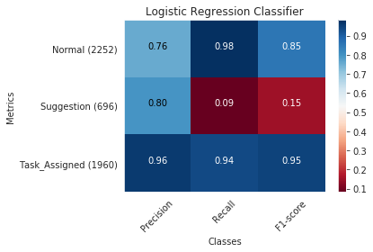
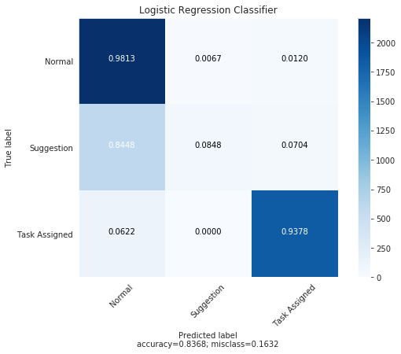
Logistic Regression Classifier

Slide 42
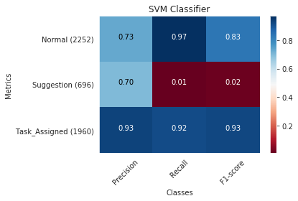

Support Vector Machine Classifier

Slide 43
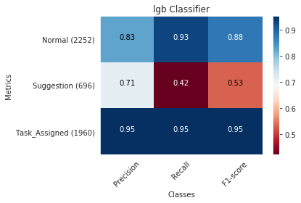
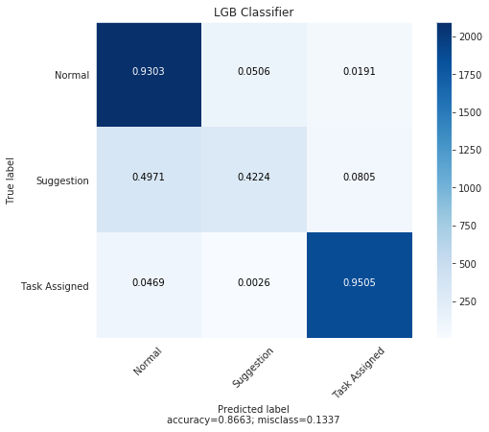
LightGBM Classifier

Slide 44
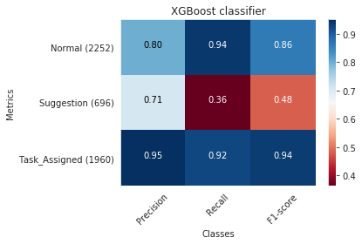

XGBoosting Classifier

Slide 45
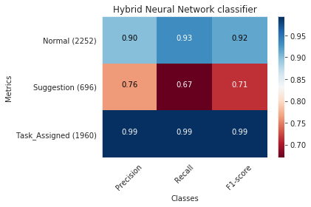

Hybrid Neural Network Classifier

Slide 46
FYP II Deliverables
Important Features Selection and Text Summarization
Web UI
Whole as a System

Slide 47


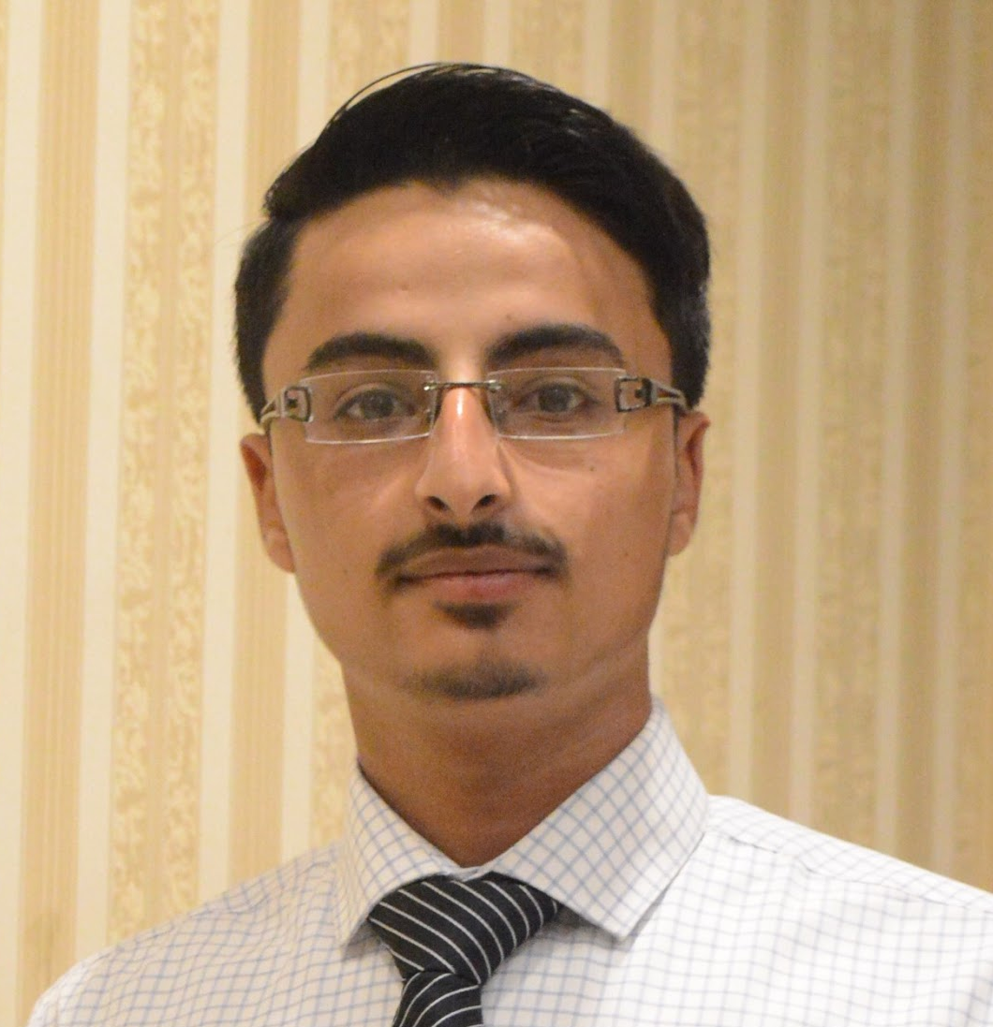

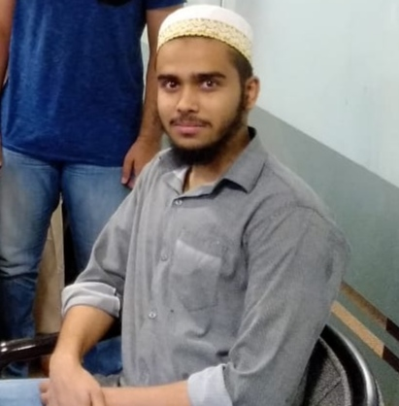

Dr. MUHAMMAD RAFI
Mehdi Raza Rajani
(FYP SUPERVISOR)
Email Address: muhammad.rafi@nu.edu.pk
LinkedIn: muhammad-rafi-34339219
(GROUP LEADER)
Email Address: k163904@nu.edu.pk
GitHub: mehdirazarajani
LinkedIn: mehdirazarajani572
TEAM MEMBERS
Hussain Yousuf
Hussain Yousuf
Shehryar Naeem
Email Address: k163805@nu.edu.pk
GitHub: HussainYousuf
LinkedIn: hussain-yousuf-93c3757
Email Address: k163950@nu.edu.pk
GitHub: shehryarnaeem
LinkedIn: shehryar-naeem-291a3016b

Slide 48
MINUTES OF MEETING
The End
THANK YOU

